Slide 1




PROJECT
SPACE SOFTWARE
By:
Arda Erdal
Aral Deniz Uzun
Talha Demirbilek
Ensar Demirbilek
Mürsel Efe Can Çalışkan

Slide 2

Our Challenge
GeoAI Reimagined
Our challenge is to develop an accurate AI model that could be useful in a range of critical geospatial applications, such as disaster recovery operations, environmental change monitoring geological data discovery, and more.

Slide 3
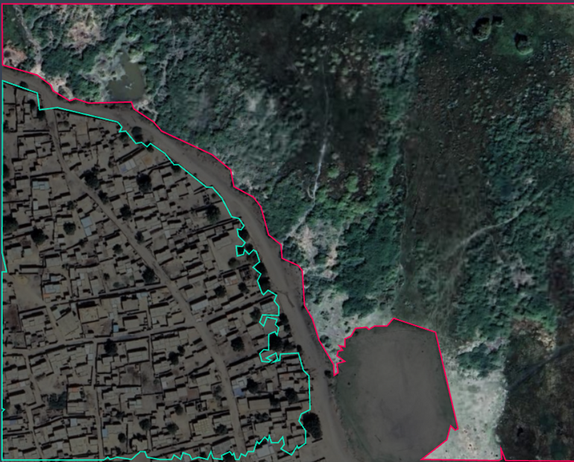
Our Goal
In this project, our goal is to leverage the power of AI to enable a range of critical geospatial applications such as environmental planning, environmental change monitoring, geospatial data discovery and more.
FINDING YOUR CREATIVE NICHE | CHC 2020

Slide 4
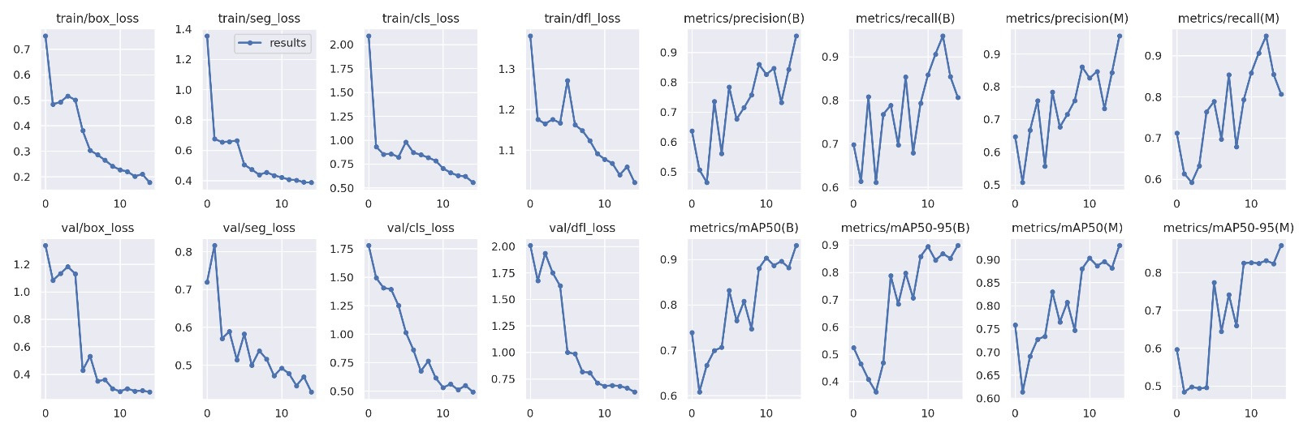
....CHART CREATED BY THE ARTIFICIAL INTELLIGENCE (AI) WE WROTE USING THE PYTHON PROGRAMMING LANGUAGE
FINDING YOUR CREATIVE NICHE | CHC 2020

Slide 5
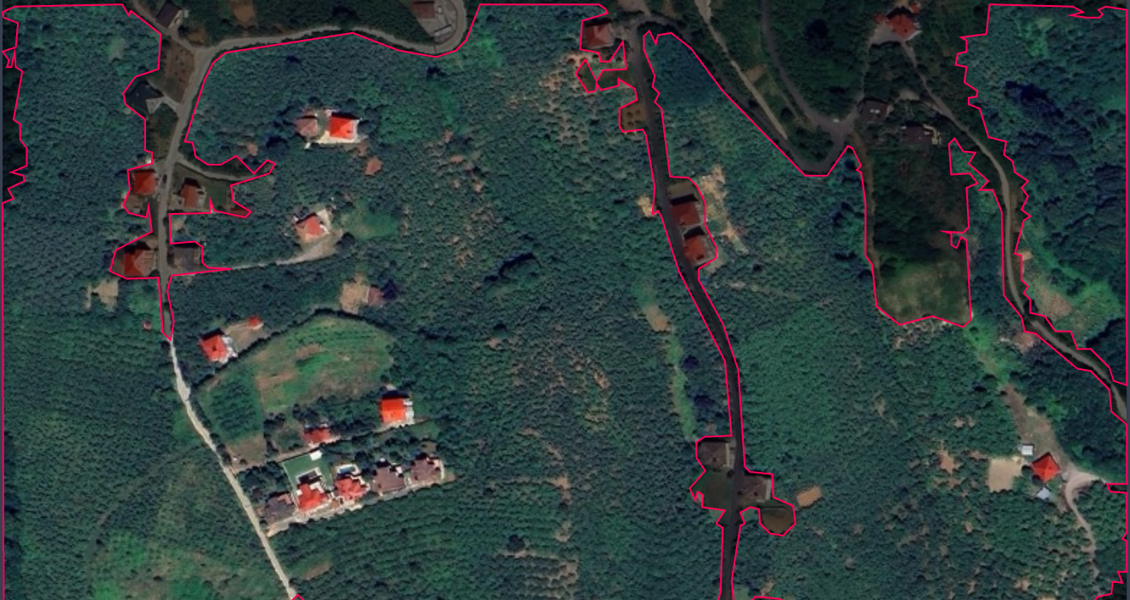
Availability
What Makes We Different?
In our program, everyone will be able to create and observe the designed visual without difficulty. And with a simple interface and design we aim to make it accessible to ever

Slide 6
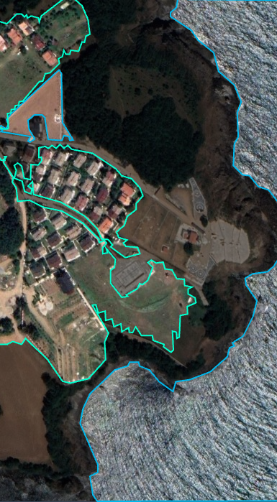
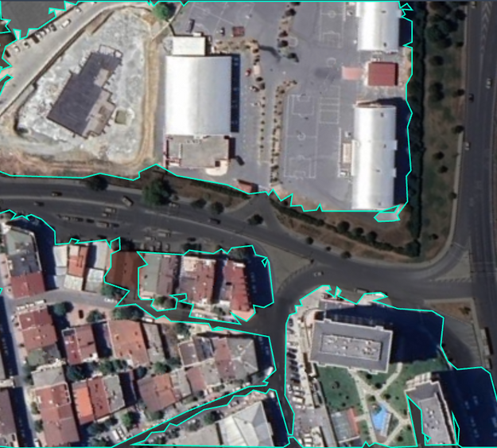
Where can we use this program in daily life?
It can be used in many areas such as school projects, so that civil engineers can more easily obtain information about where to build, and the availability of the place to build.

Slide 7
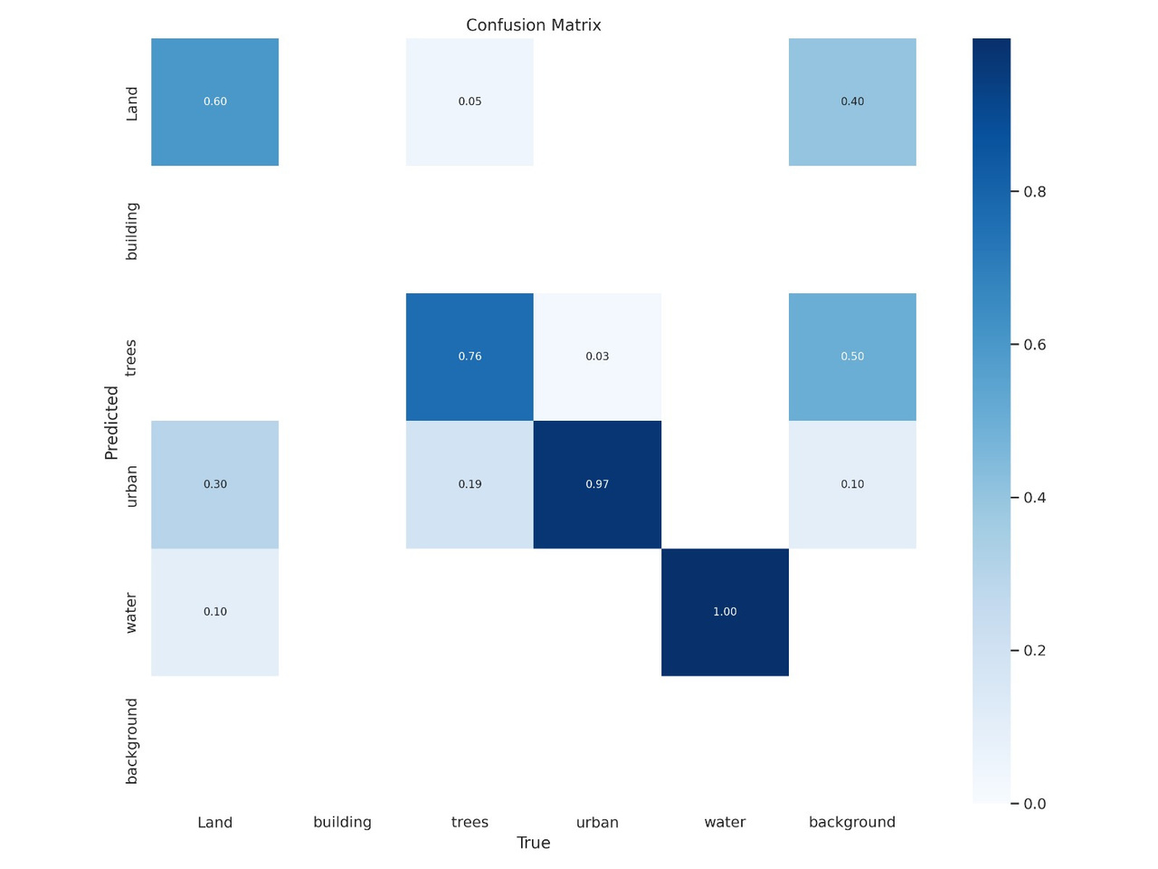
Confusion matrix-prediction graph that emerged while doing our project

Slide 8
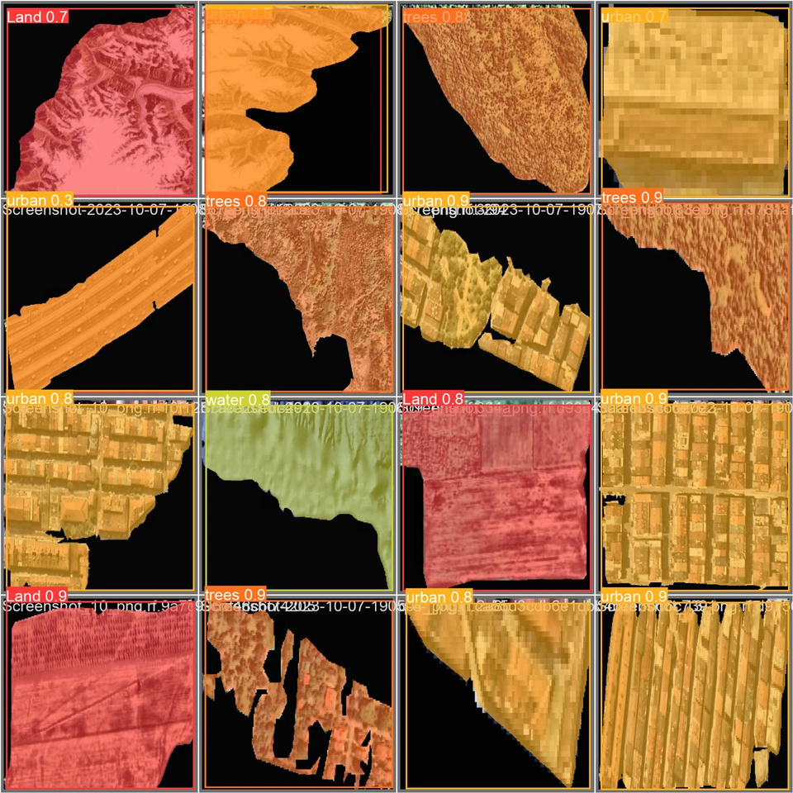
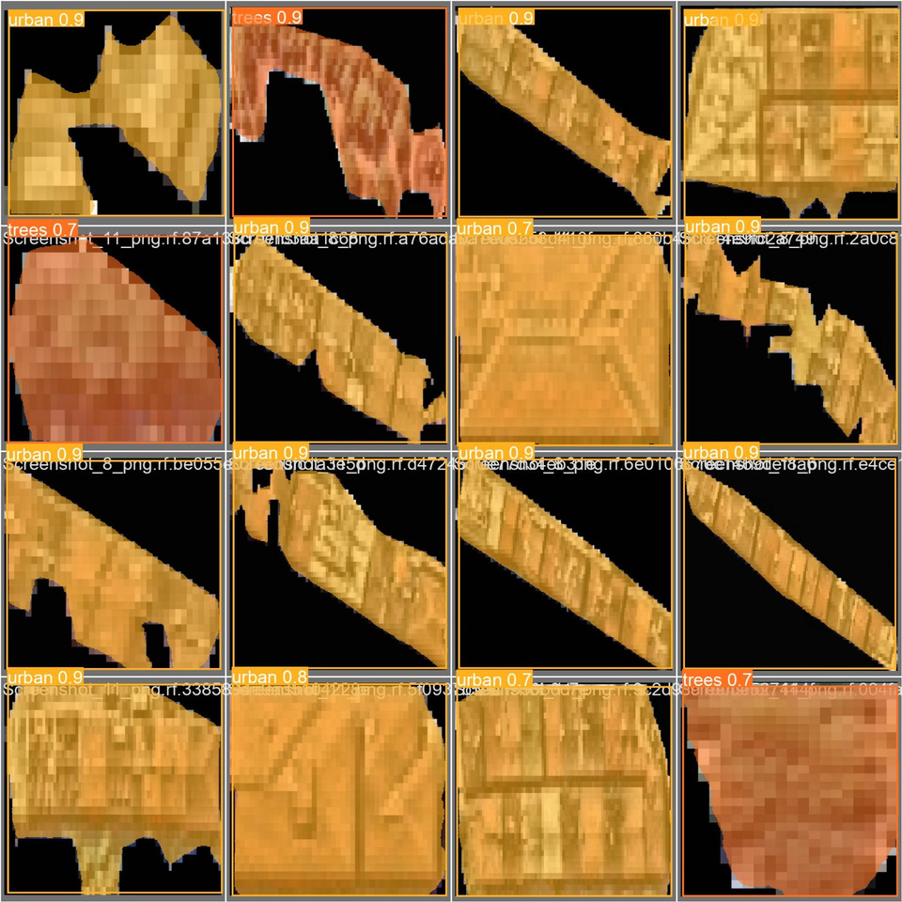
We used different colors
Similar structures, Similar colors
While making the program, structures that are different in the area searches are labelled with different colors.
We used similar colors when modeling similar or identical structures.

Slide 9
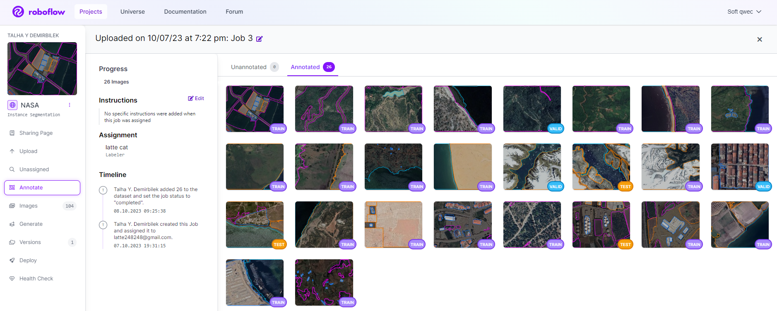
Labeling studies on data in the demo phase

Slide 10
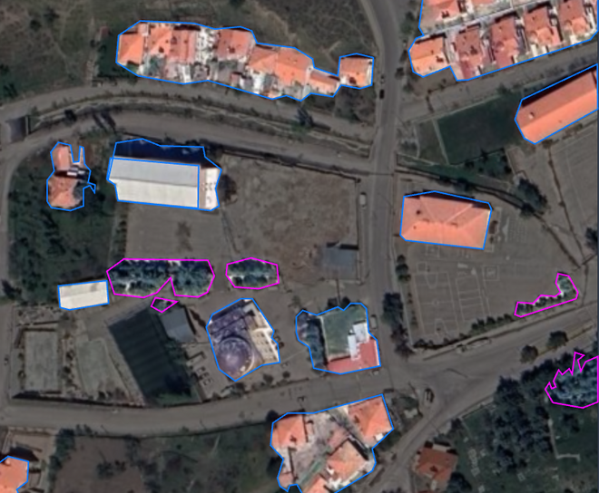
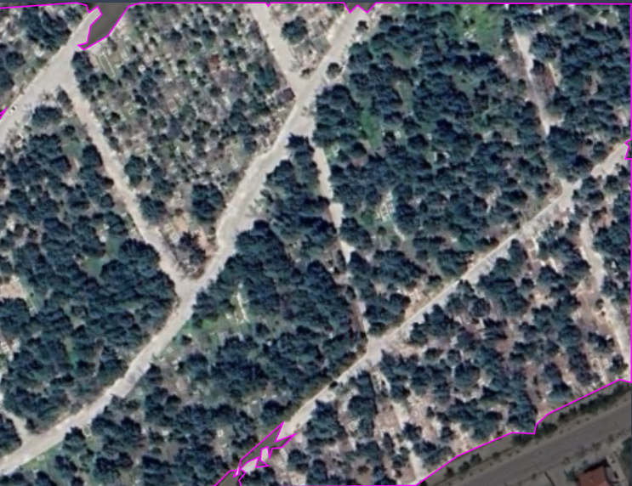
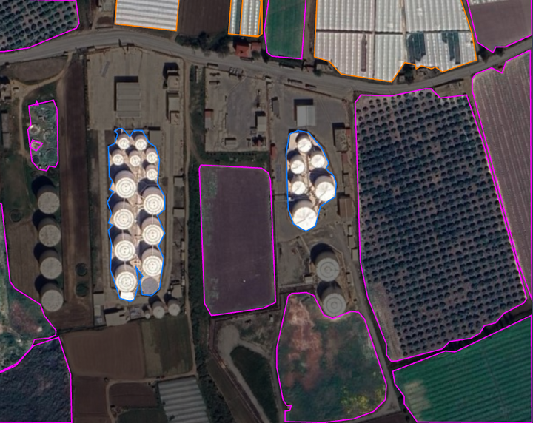
LABELLING EXAMPLES

Slide 11
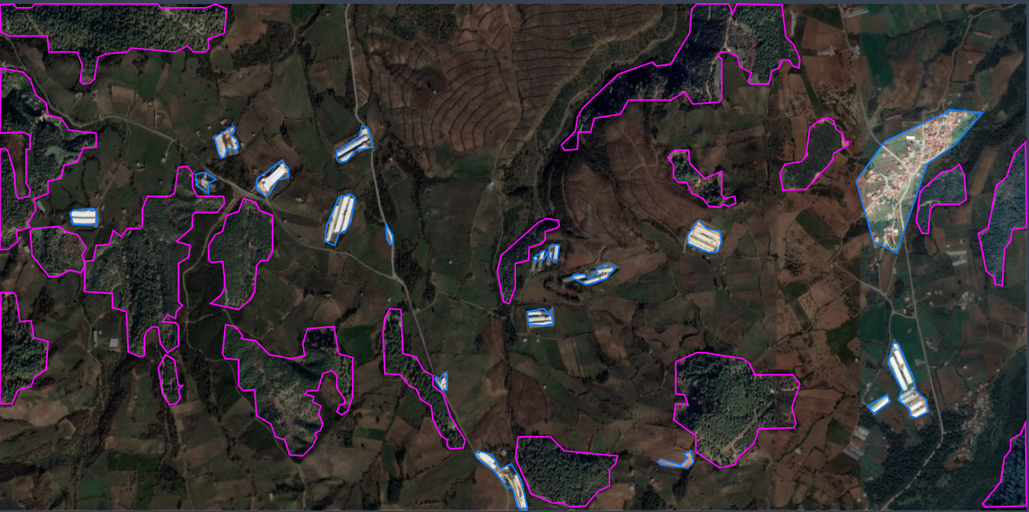
A LABELING EXAMPLE THAT WE STUDIED IN DETAIL

Slide 12
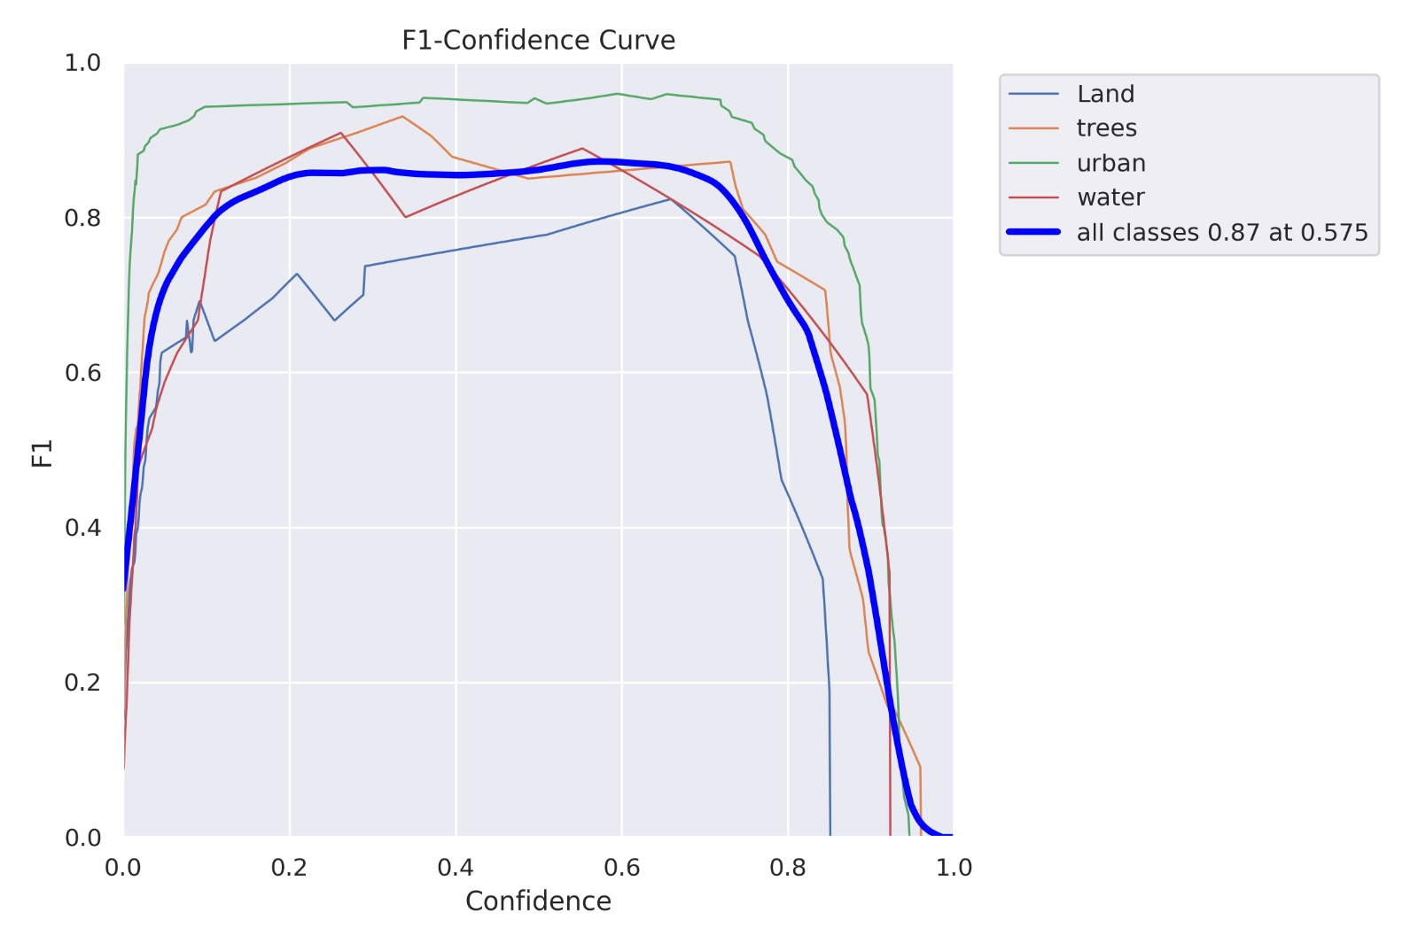
F1-CONFIDENCE CURVE

Slide 13
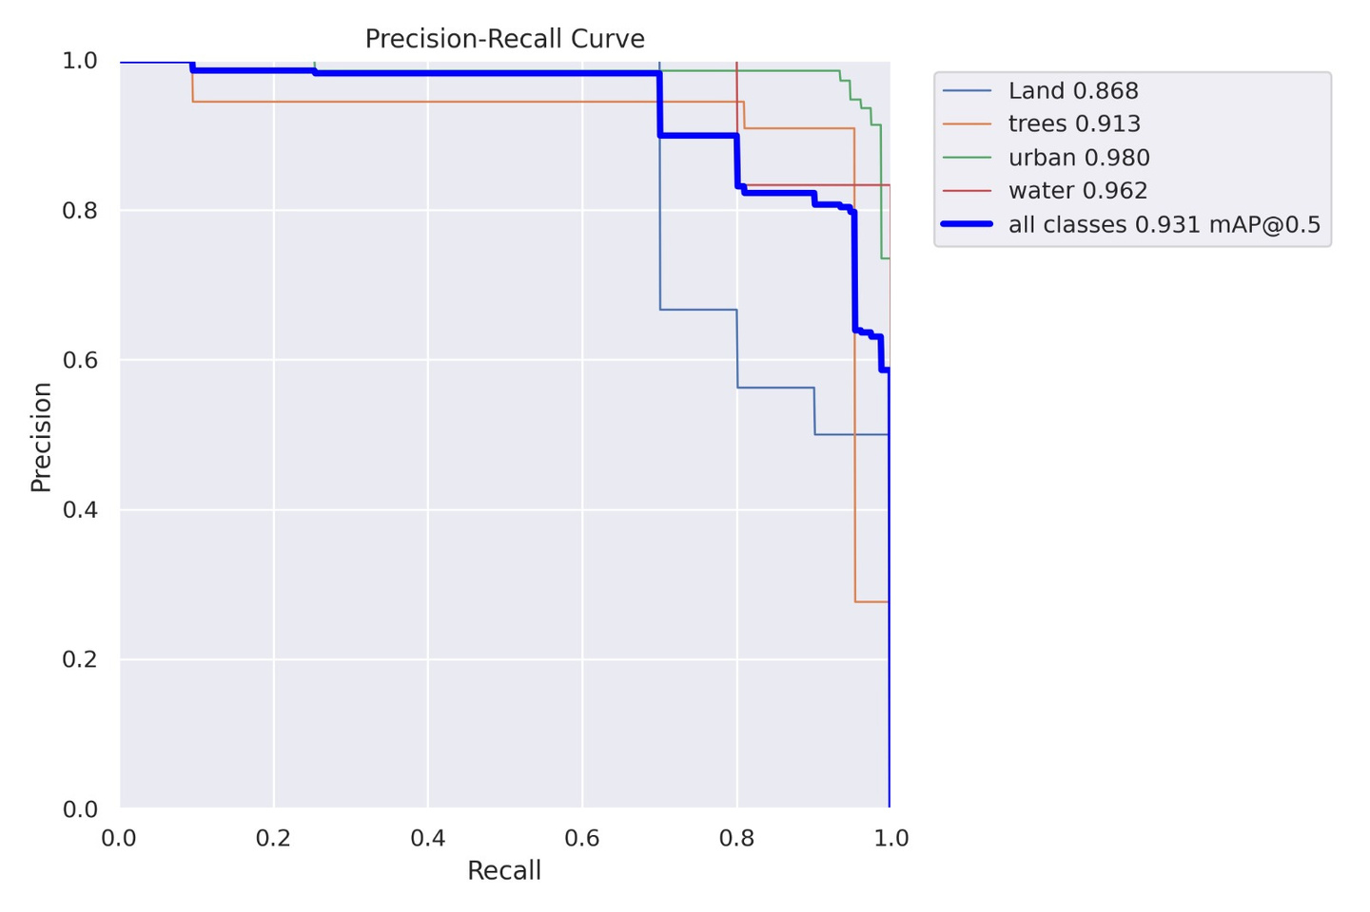
Precision-Recall Curve

Slide 14

HOW DOES IT WORK
YOLO algorithm is an algorithm based on regression, instead of selecting the interesting part of an Image, it predicts classes and bounding boxes for the whole image in one run of the Algorithm.

Slide 15
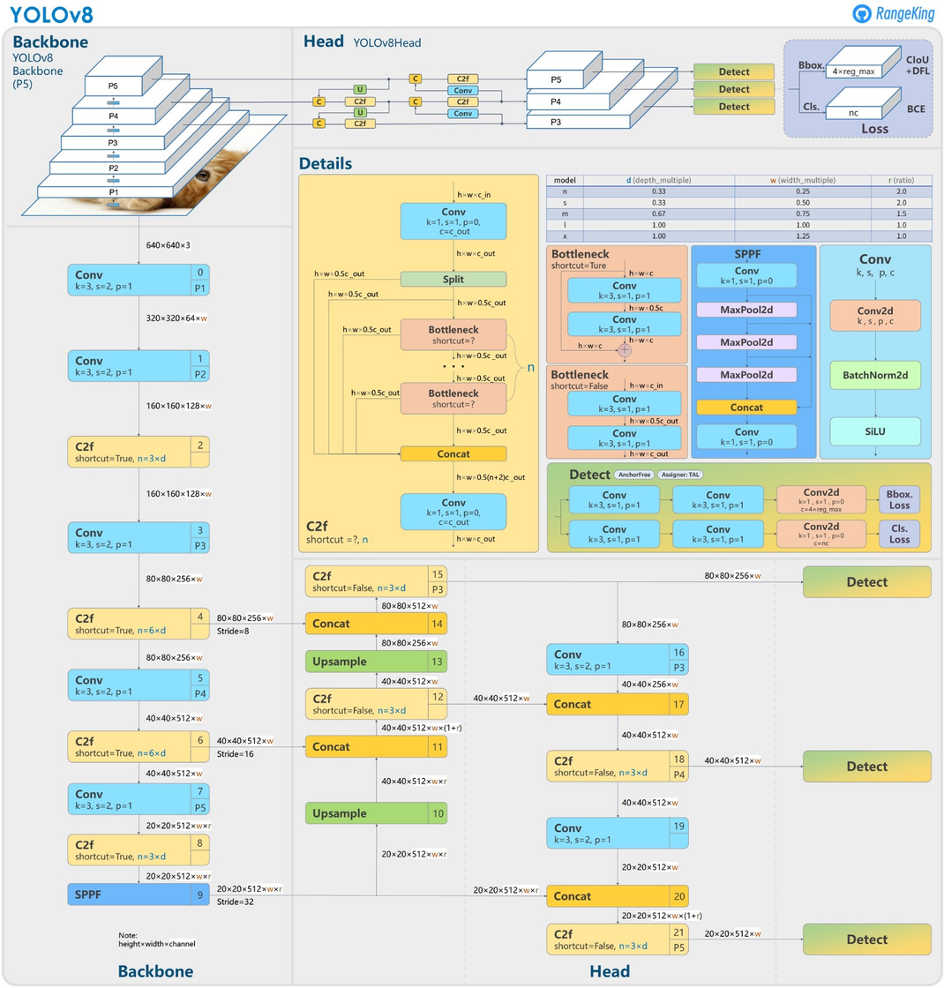
HOW DOES IT WORK
Object detection is a popular task in computer vision.
It deals with localizing a region of interest within an image and classifying this region like a typical image classifier. One image can include several regions of interest pointing to different objects. This makes object detection a more advanced problem of image classification.
YOLO (You Only Look Once) is a popular object detection model known for its speed and accuracy. It was first introduced by Joseph Redmon et al. in 2016 and has since undergone several iterations, the latest being YOLO v7.
In this article, we will discuss what makes YOLO v7 stand out and how it compares to other object detection algorithms.

Slide 16
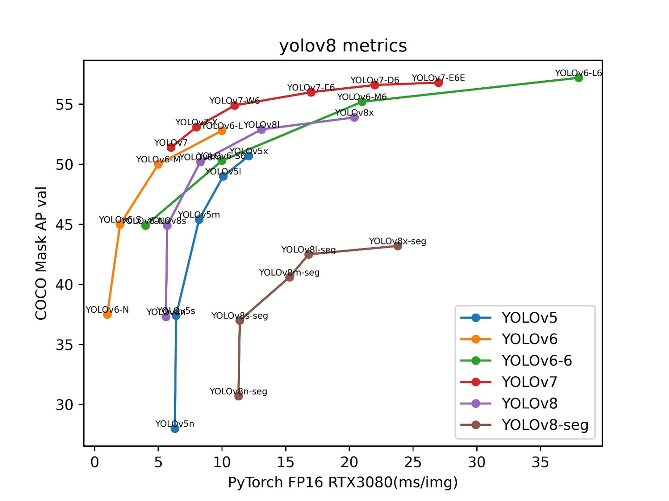
Yolov8 vs older versions of Yolo

Slide 17
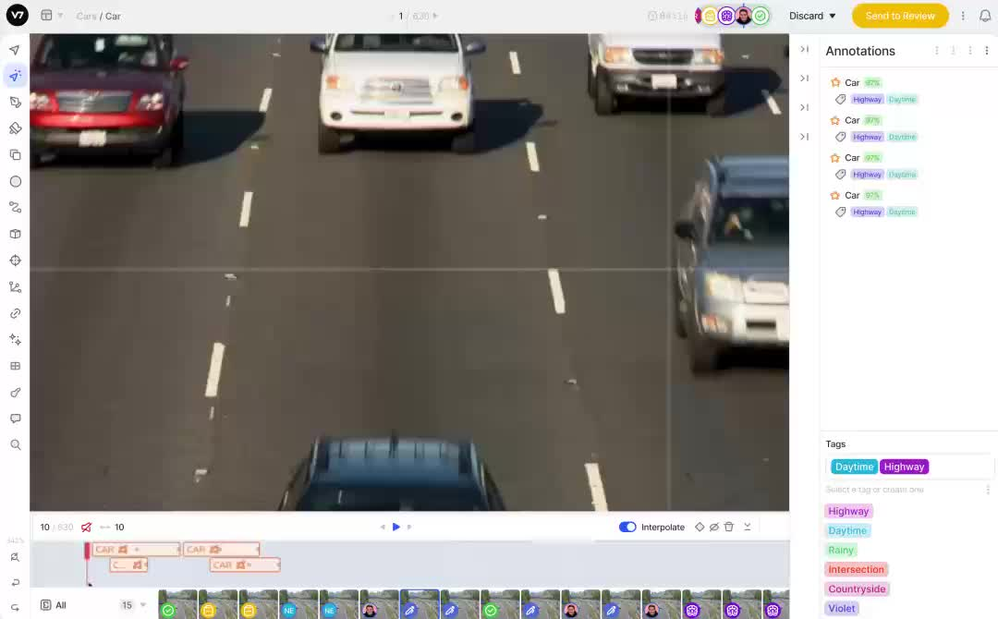
SAMPLE STUDY MADE WITH YOLO CODING LANGUAGE

Slide 18
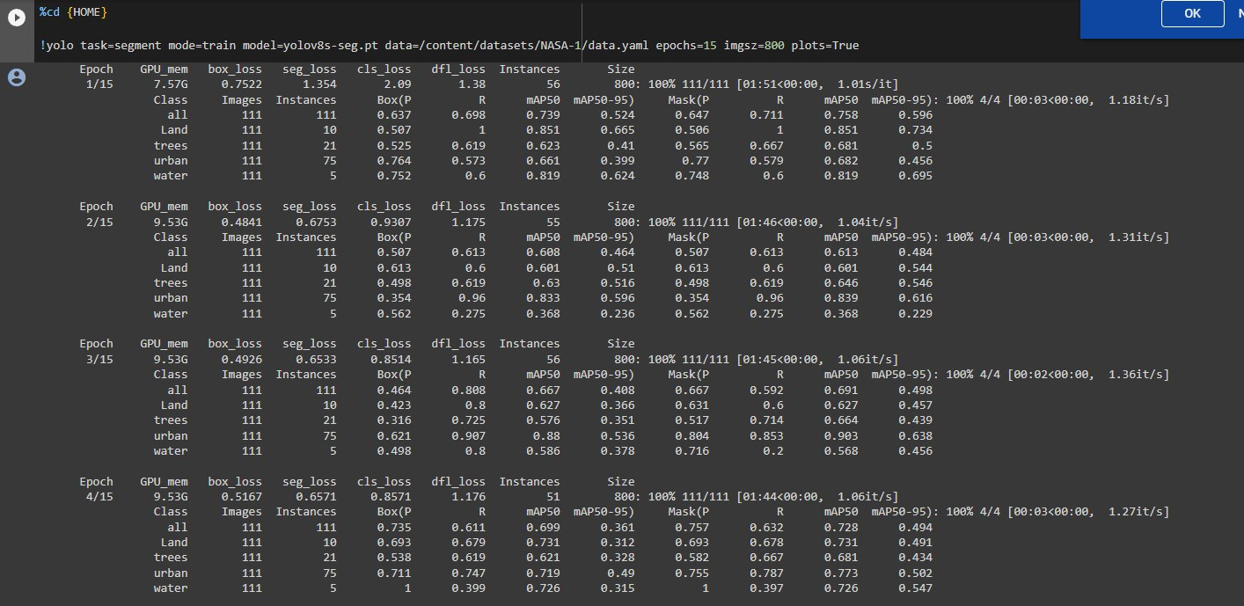
Data about how we train AI

Slide 19
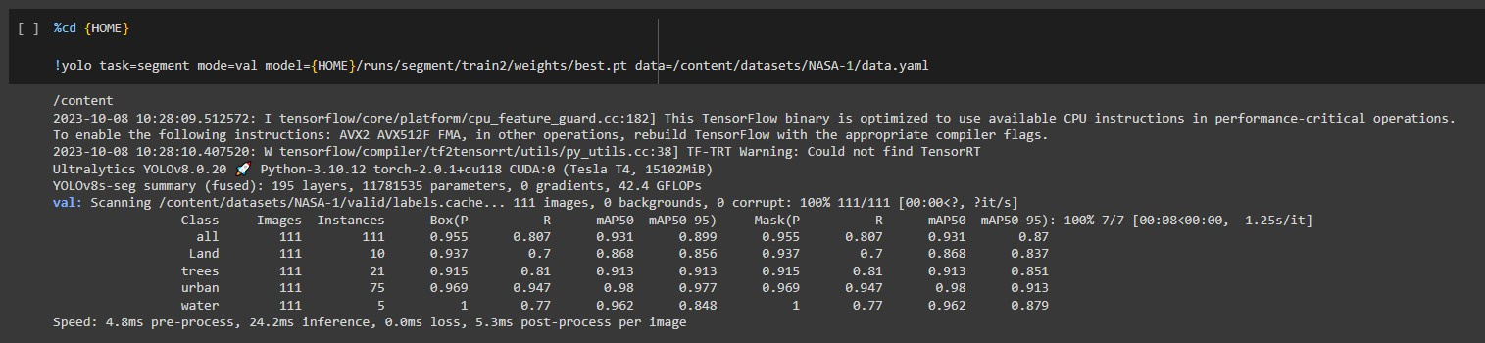

VALIDATION OF THE TRAINED MODEL

Slide 20

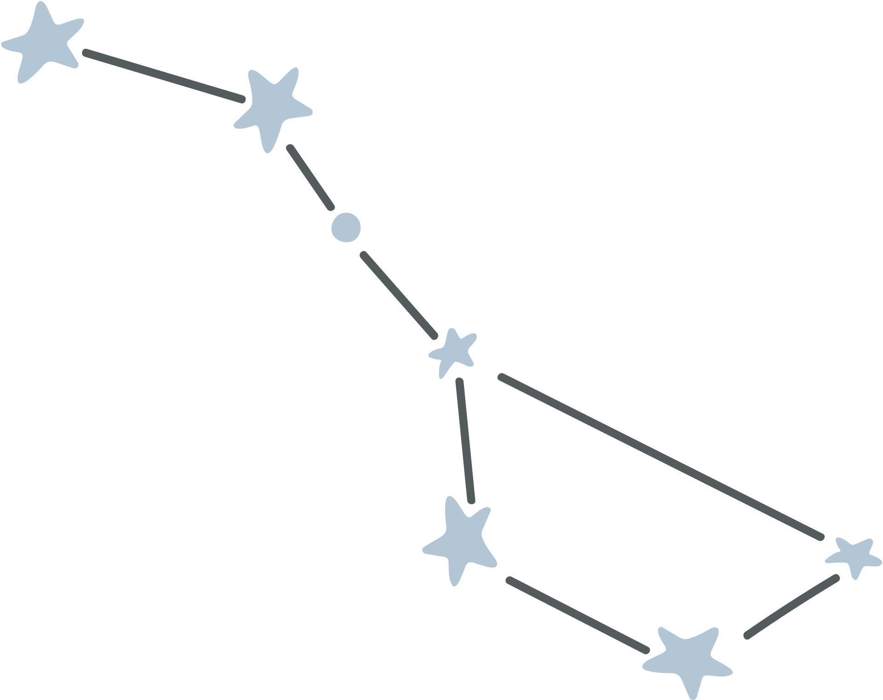
PREDICTION/TESTING

Slide 21
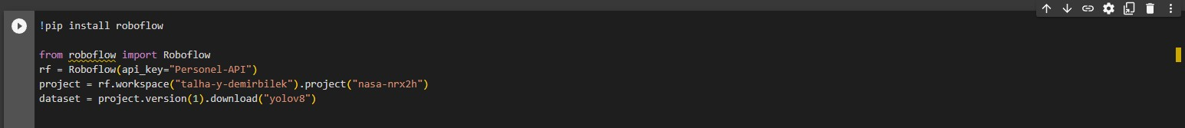
Importing The Dataset

Slide 22
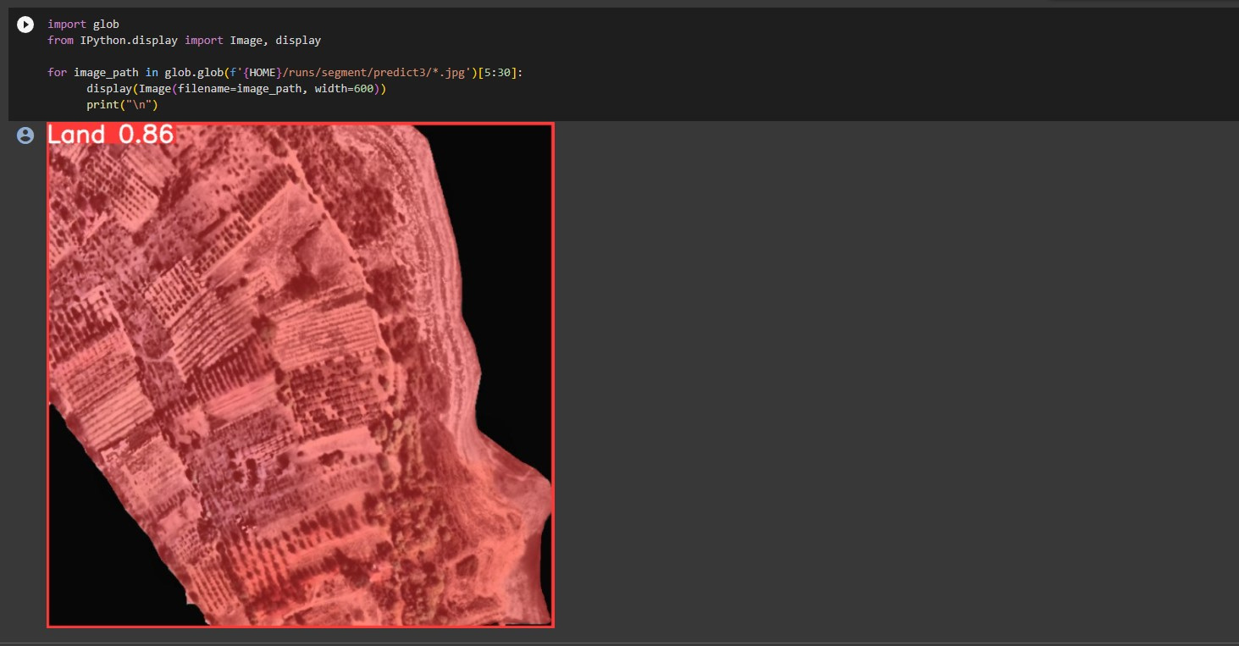
TESTING SAMPLE VISUALIZATION

Slide 23
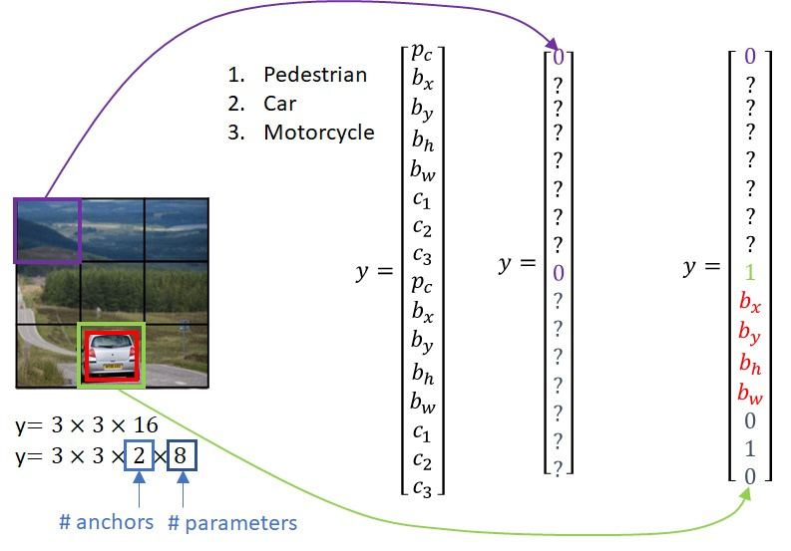

Slide 24

Where is object detection used today?
Today, object recognition is the core of most vision-based AI software and programs. Object detection plays an important role in scene understanding, which is popular in security, construction, transportation, medical, and military use cases.

Slide 25


The End
We thank you for reading our presentation until the end and wish everyone success.

